Slide 1





My dream house

Slide 2
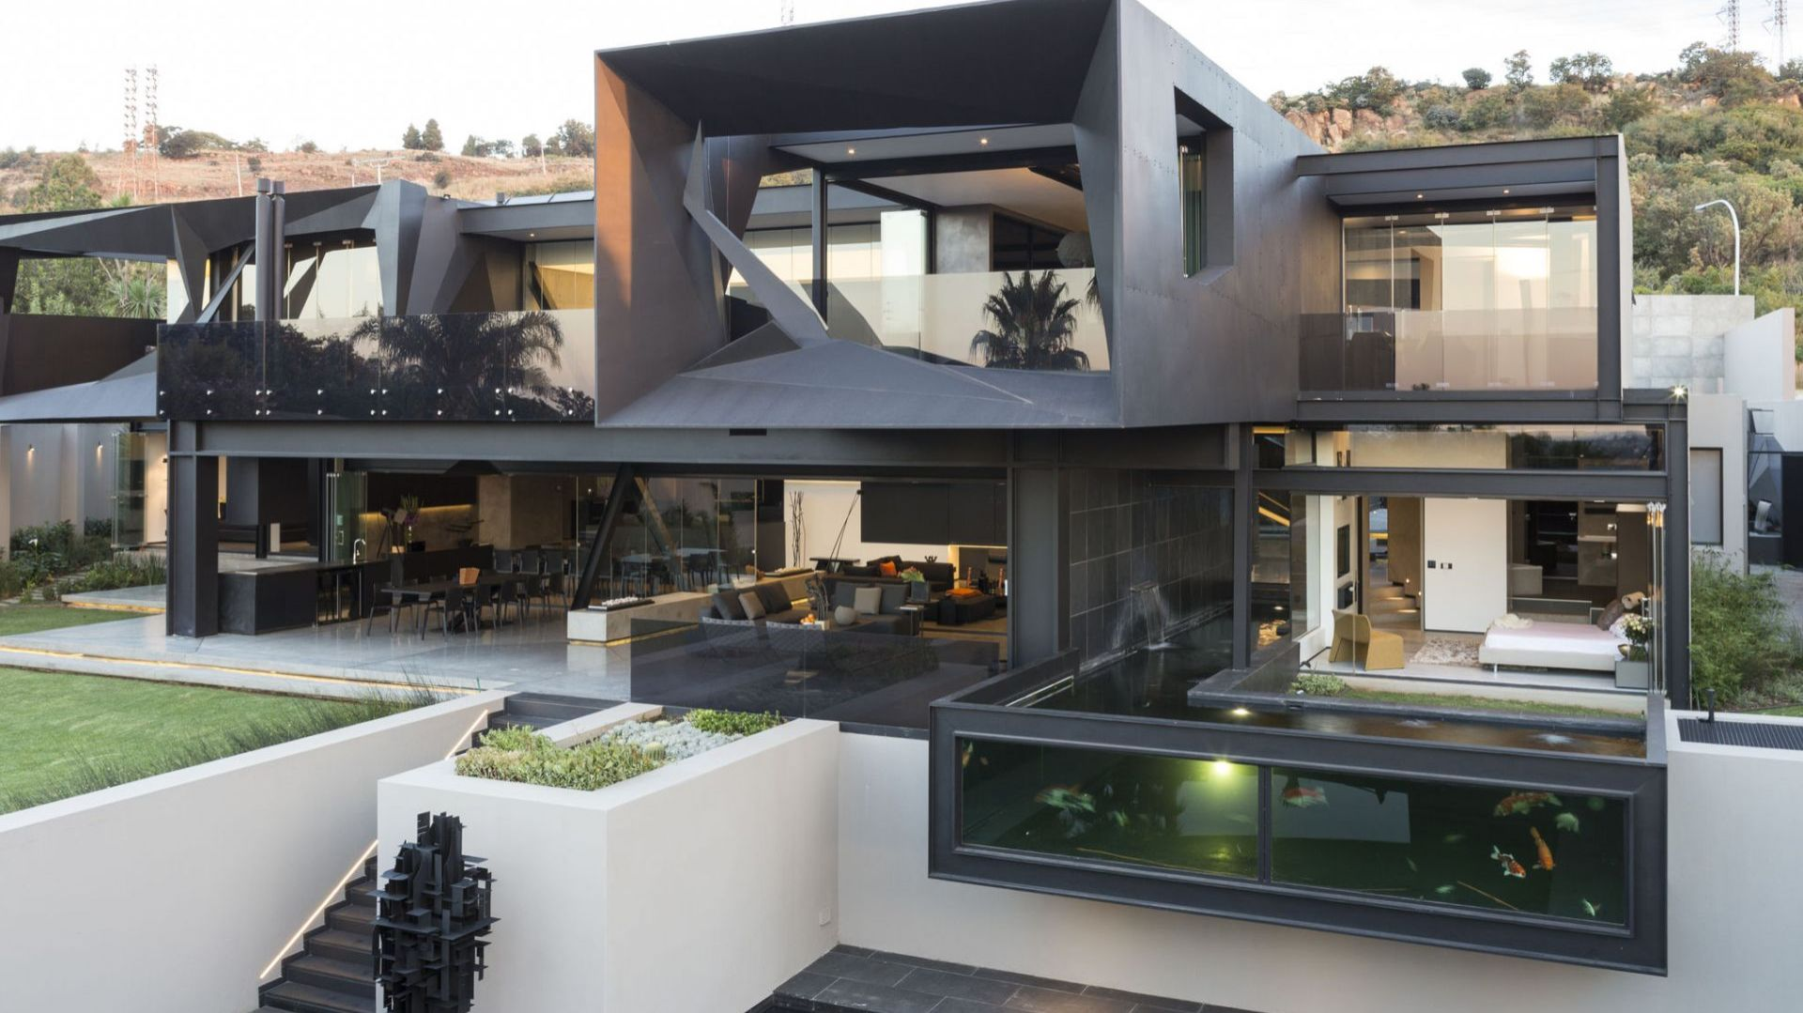

This is my dream house

Slide 3
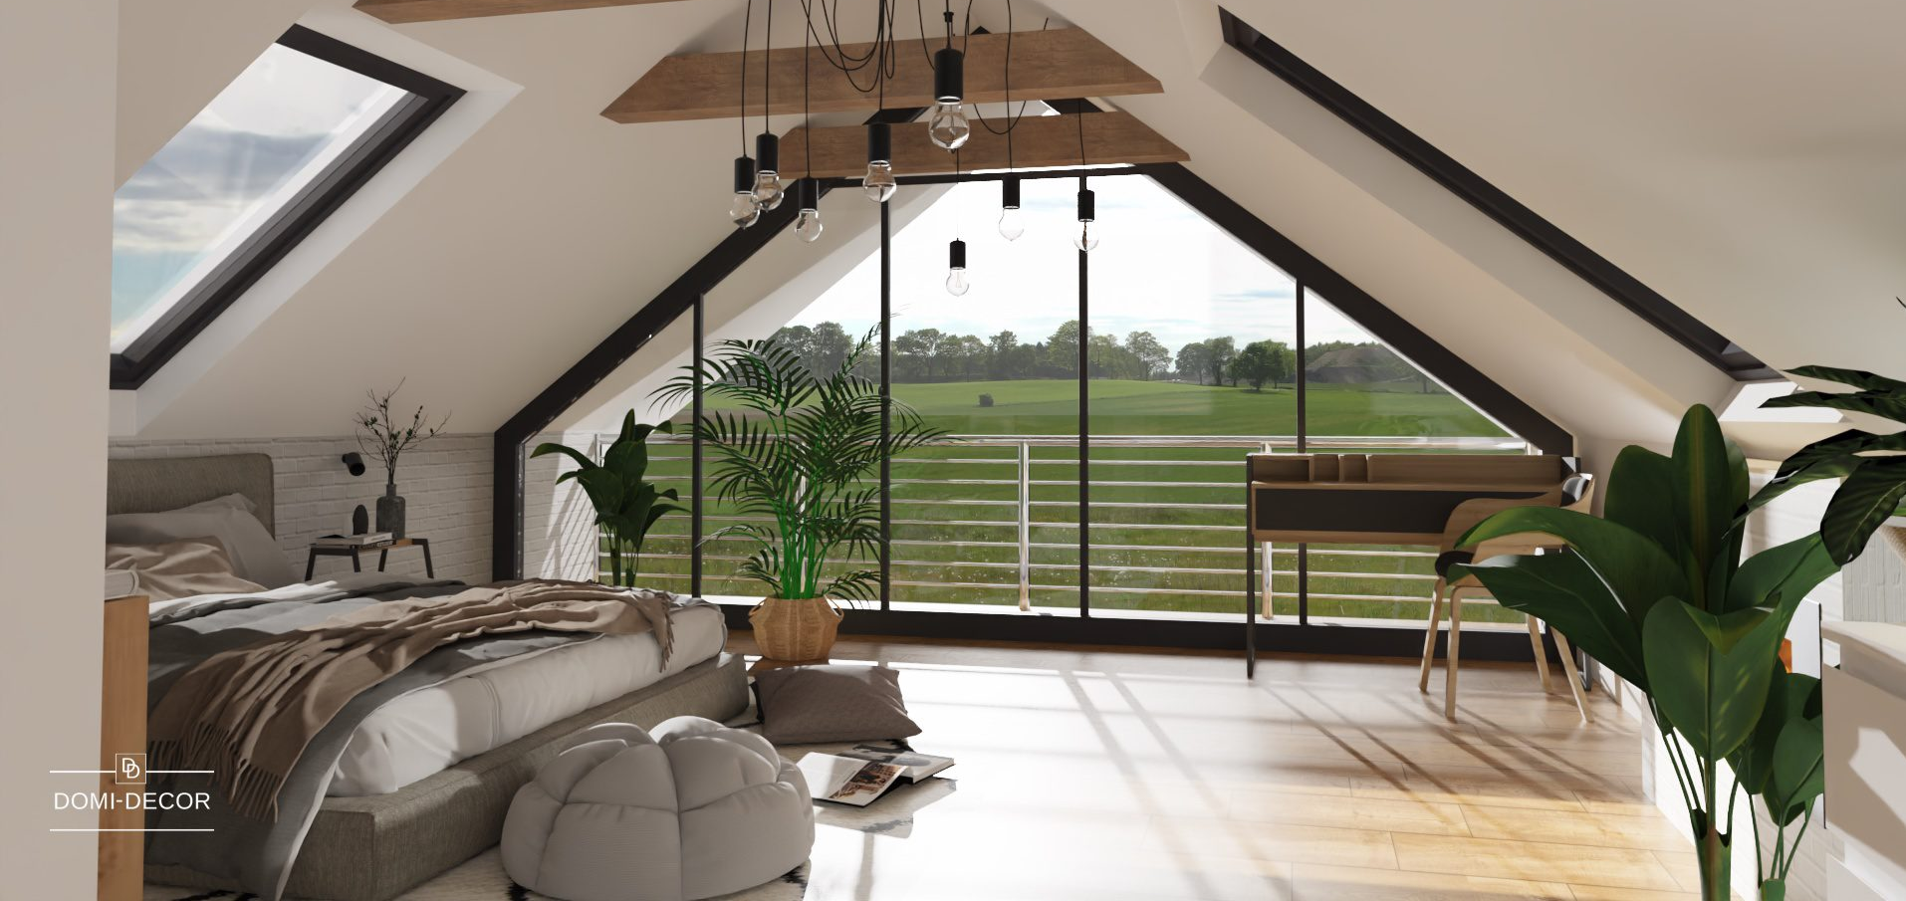

This is my dream bedroom. It’s my favorite room.

Slide 4



There are three windows - one is big, and two are small.

Slide 5




There are some plants.

Slide 6

There is a big bed.

Slide 7

And there is my dog!

Slide 8
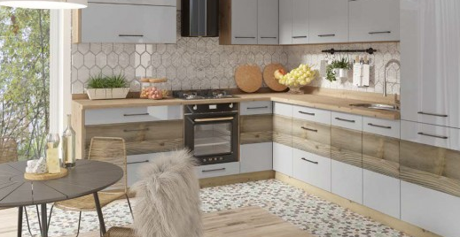
This is my dream kitchen. I like this room too.

Slide 9

There is a table and some chairs.

Slide 10

There is an oven.

Slide 11


There is a sink.

Slide 12
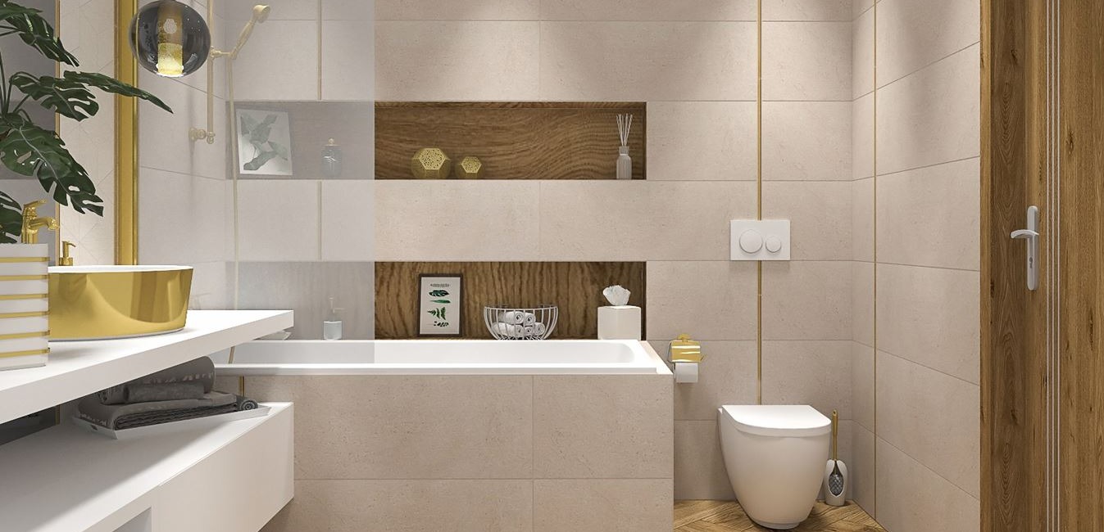
This is my dream bathroom.

Slide 13


There is a sink and a medium mirror.

Slide 14

There is a toilet next to the bath.

Slide 15

And there is the bath.

Slide 16
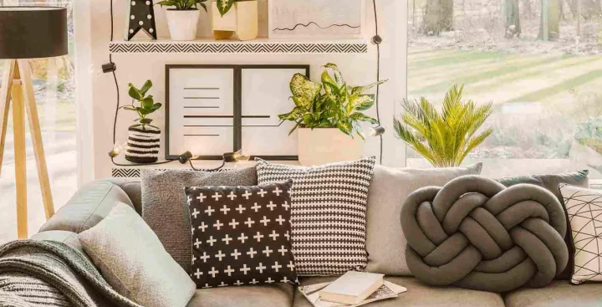
This is the living room.

Slide 17

There is a big sofa.

Slide 18

There is a black lamp.

Slide 19




There are some plants too.

Slide 20
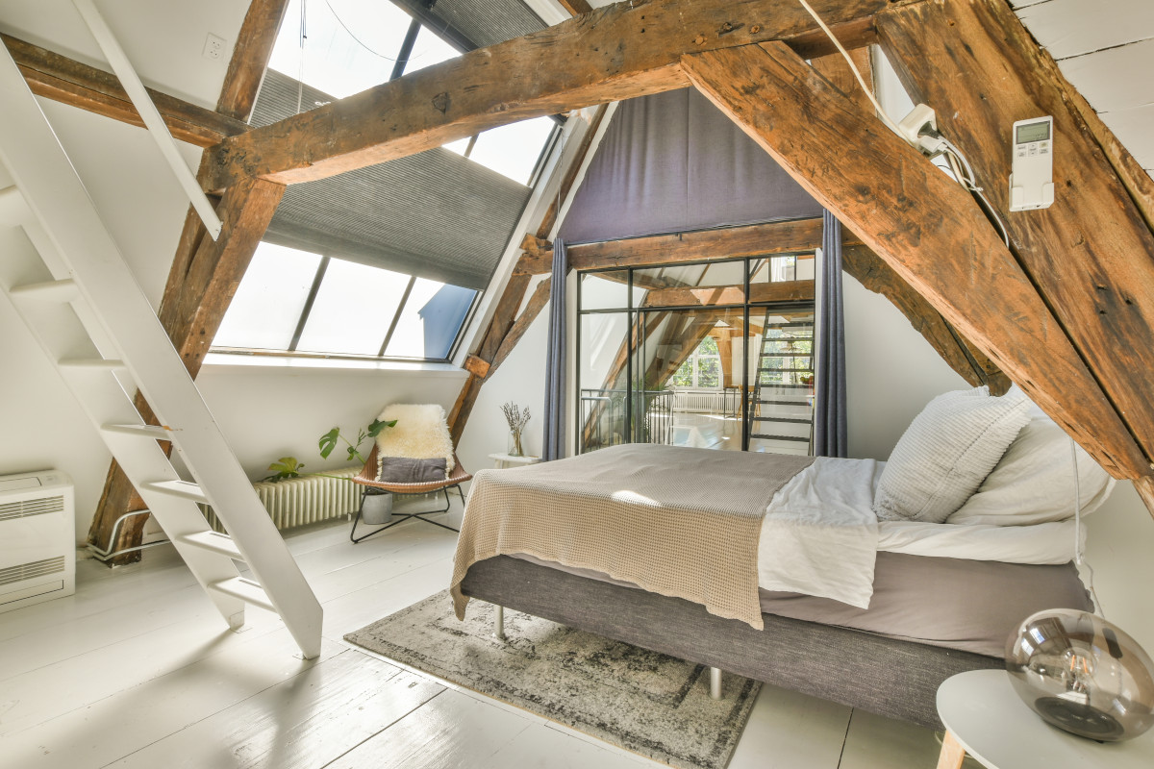
This is the attic. It’s a bedroom for guests too and it’s very cozy.

Slide 21

There is a bed.

Slide 22

There is a radiator for warmth.

Slide 23

There is a comfortable chair.

Slide 24
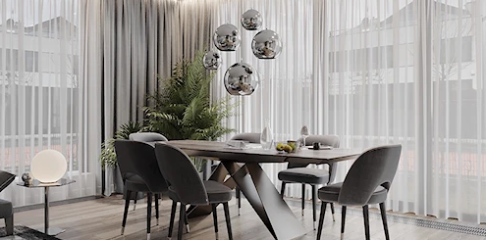
There’s also a dining room.

Slide 25

There is a medium table.

Slide 26

There is a big plant.

Slide 27



And there are some chairs!

Slide 28
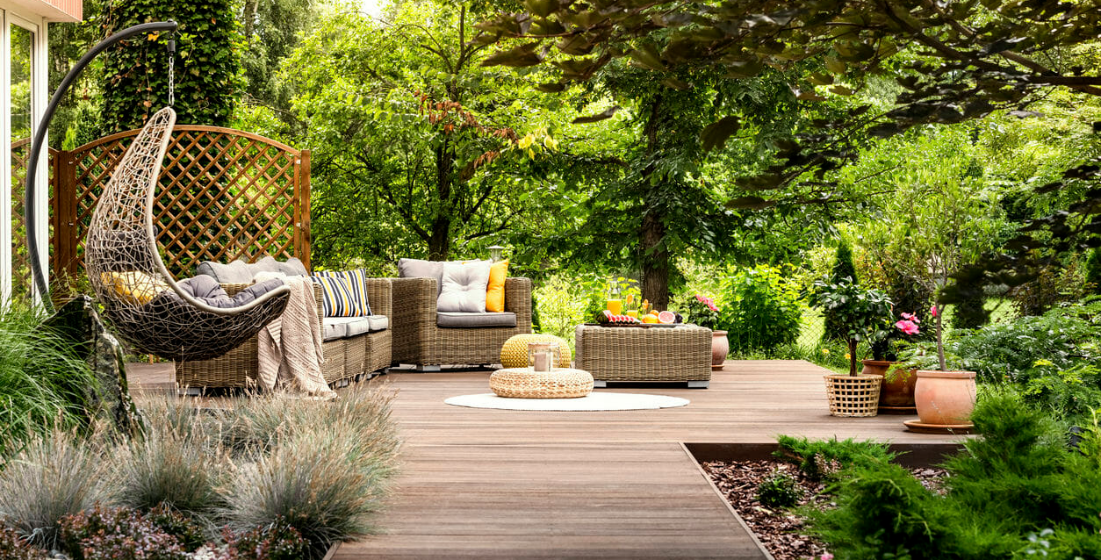
Of course there is a garden!

Slide 29






There are some trees, plants and flowers.

Slide 30


There are two armchairs.

Slide 31
There is a hanging one too!

Slide 32
This is my dream house. I hope you like it.
The end

